Slide 1
Section 9.7
Infinite Series:
“Maclaurin and Taylor Polynomials”

Slide 2
All graphics are attributed to:
Calculus,10/E by Howard Anton, Irl Bivens, and Stephen Davis
Copyright © 2009 by John Wiley & Sons, Inc. All rights reserved.”

Slide 3
Introduction
In a local linear approximation, the tangent line to the graph of a function is used to obtain a linear approximation of the function near the point of tangency.
In this section, we will consider how one might improve on the accuracy of local linear approximations by using higher-order polynomials as approximating functions.
We will also investigate the error associated with such approximations.

Slide 4
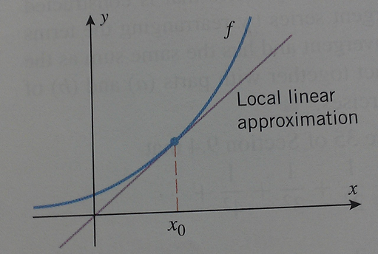
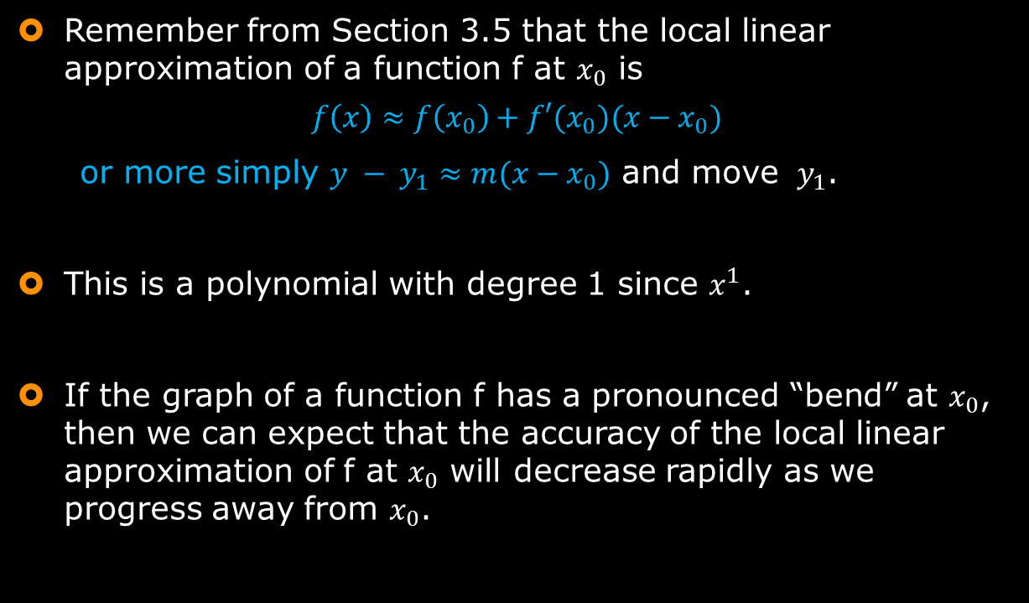
Local Linear Approximations
Remember from Section 3.5 that the local linear approximation of a function f at $x_{0}$ is
$$f\left(x\right)≈f\left(x_{0}\right)+f′(x_{0})(x−x_{0})$$
or more simply $y − y_{1}≈m(x−x_{0})$ and move $y_{1}$.
This is a polynomial with degree 1 since $x^{1}$.
If the graph of a function f has a pronounced “bend” at $x_{0}$, then we can expect that the accuracy of the local linear approximation of f at $x_{0}$ will decrease rapidly as we progress away from $x_{0}$.

Slide 5
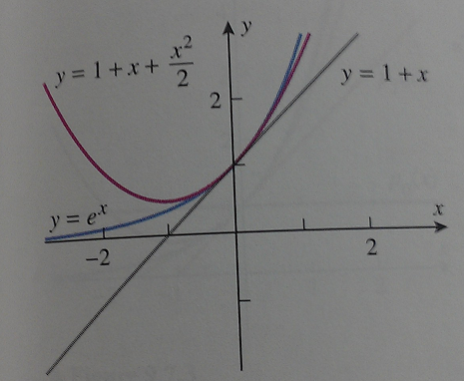
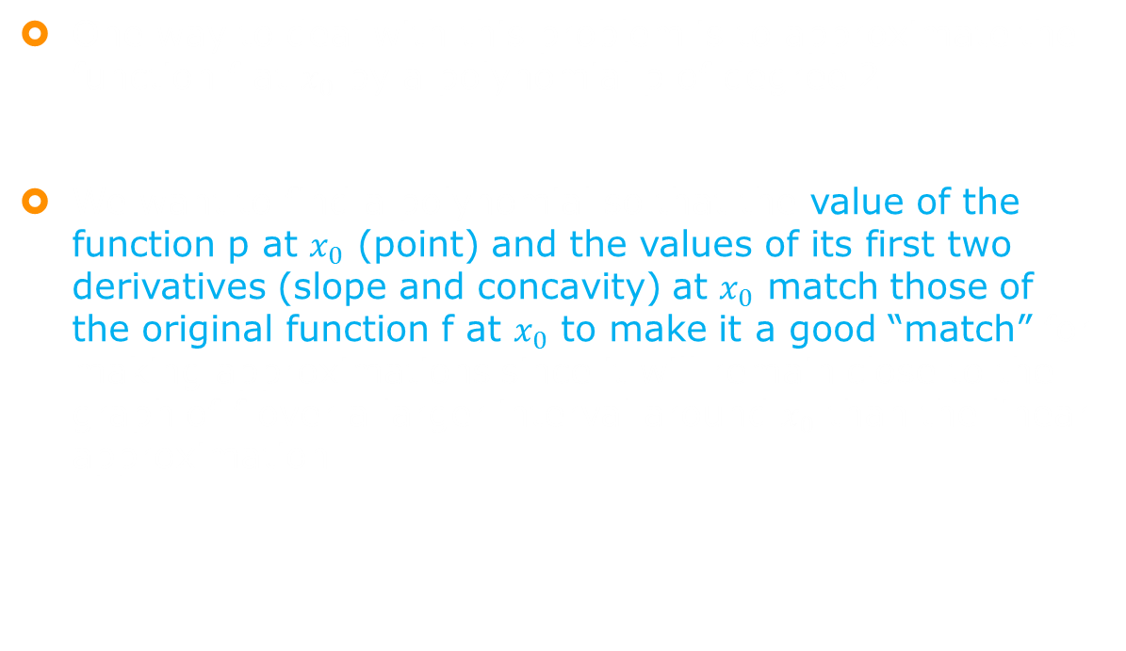
Local Quadratic Approximations
One way to deal with this problem is to approximate the function f at $x_{0}$ by a polynomial p of degree 2.
We want to find a polynomial so that the value of the function p at $x_{0}$ (point) and the values of its first two derivatives (slope and concavity) at $x_{0}$ match those of the original function f at $x_{0}$ to make it a good “match” for making approximations since it will remain close to the graph of f over a larger interval around $x_{0}$ than the linear approximation.

Slide 6

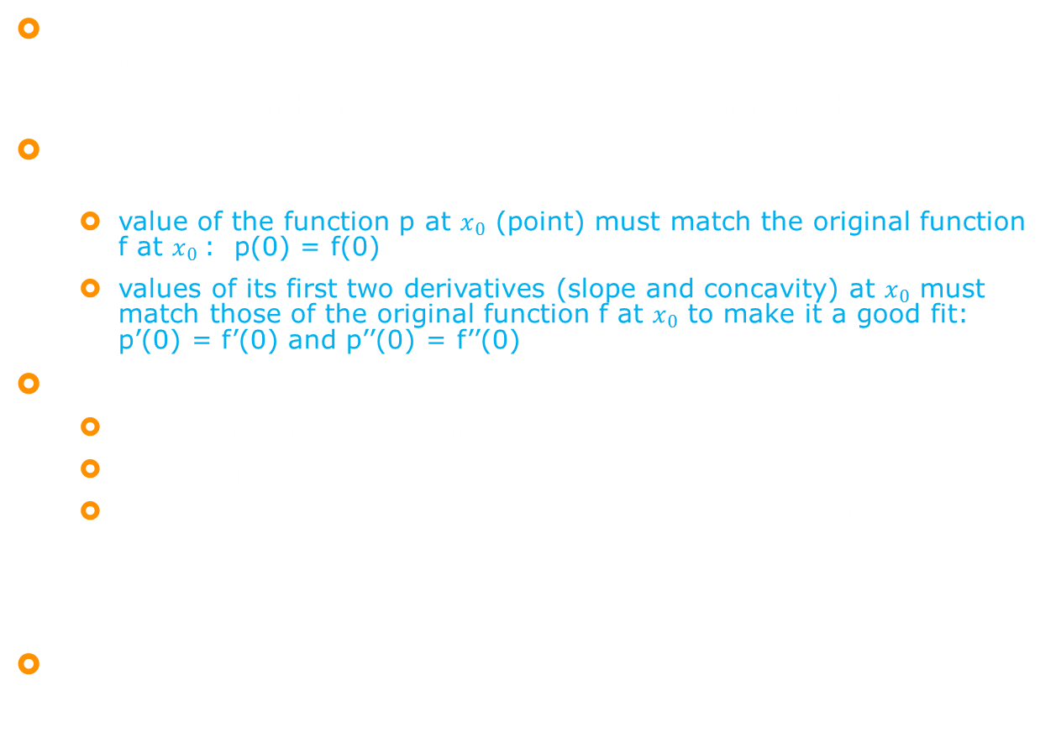
Substitution for Local Quadratic Approximation
A general formula for a local quadratic approximation f at x = 0 comes from y=ax²+bx+c:
$f(x)≈ c_{0}+ c_{1}x+ c_{2}x^{2}$ p = $c_{0}+ c_{1}x+ c_{2}x^{2}$
Remembering the requirements from the previous slide will help perform the substitutions necessary to find this approximation.
  value of the function p at $x_{0}$ (point) must match the original function f at $x_{0}$: p(0) = f(0)
  values of its first two derivatives (slope and concavity) at $x_{0}$ must match those of the original function f at $x_{0}$ to make it a good fit: p’(0) = f’(0) and p’’(0) = f’’(0)
Substitution
  p(0) = $c_{0}+ c_{1}0+ c_{2}0^{2}$ = $c_{0}$ means p(0) = f(0) = $c_{0}$
  p’(0) = $c_{1}+2c_{2}0$ = $c_{1}$ means p’(0) = f’(0) = $c_{1}$
  p””(0) = 2$c_{2}$ means p’’(0) = f’’(0) = 2$c_{2}$
  and gives $c_{2}$ = $\frac{\text{f}\text{’’(0)}}{2}$
Therefore, $f(x)≈$

Slide 7
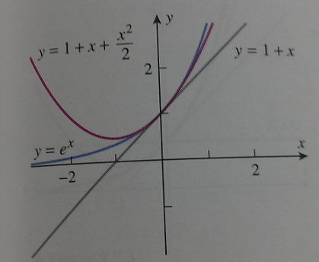

Example
Find the local linear and quadratic approximations of $e^{x}$ at x = 0 and graph y= $e^{x}$along with the two approximations.
Solution
f’(x) = $e^{x}$ and f’’(x) = $e^{x}$ so f(0)=f’(0)=f’’(0)= $e^{0}$=1
Linear approximation: y = mx + b = 1x + 1 = x + 1 $≈ e^{x}$
Quadratic approximation: use y =
y = $1+1x+ \frac{x^{2}}{2}≈e^{x}$
As expected, the quadratic approximation is more accurate than the local linear approximation (see graph).

Slide 8
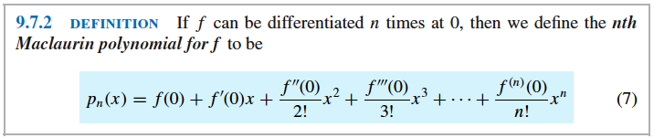
Maclaurin Polynomials
Since the quadratic approximation was better than the local linear approximation, might a cubic or quartic (degree 4) approximation be better yet?
To find out, we must extend our work on quadratics to a more general idea for higher degree polynomial approximations.
See substitution work similar to that we did for quadratics on page 650 for higher degree polynomials.

Slide 9

Colin Maclaurin (1698-1746)
Maclaurin polynomials are named after the Scottish mathematician Colin Maclaurin who received his Master’s degree and started teaching college math at the age of 17.
He worked to defend Isaac Newton’s methods and ideas and create some of his own.
He also contributed to astronomy, actuarial sciences, mapping, etc.
See more info on page 649
NOTE: The Maclaurin polynomials are the special cases of the Taylor polynomials (see later slides) in which $x_{0}=0.$

Slide 10


Example
Find the Maclaurin polynomials $p_{0}, p_{1}, p_{2}, p_{3}, and p_{n}$ for $e^{x}$.
Solution
All derivatives of $e^{x}$ are $e^{x}$
so f(0)=f’(0)=f’’(0)=f’’’(0)=…=$f^{\left(n\right)}\left(0\right)=$ $e^{0}$=1
$p_{0}$ = f(0) = 1
We already found $p_{1} \& p_{2}$ earlier (linear and quadratic approx.)
  $p_{1}$= x + 1 and $p_{2}$ = $1+1x+ \frac{x^{2}}{2}$
Cubic approximation: use $p_{3}$ =
$p_{3}$ = $1+1x+ \frac{x^{2}}{2}+ \frac{x^{3}}{6}$
General: use
$p_{n}$ =$1+1x+ \frac{x^{2}}{2}+ \frac{x^{3}}{6}$ + … + $\frac{x^{n}}{n!}$

Slide 11
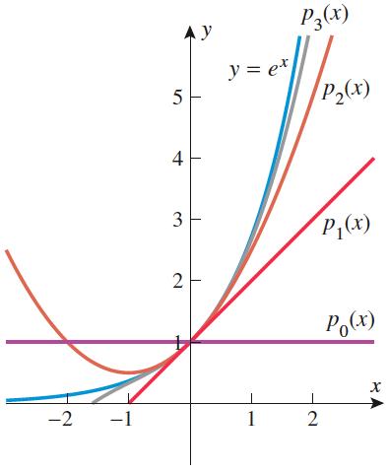
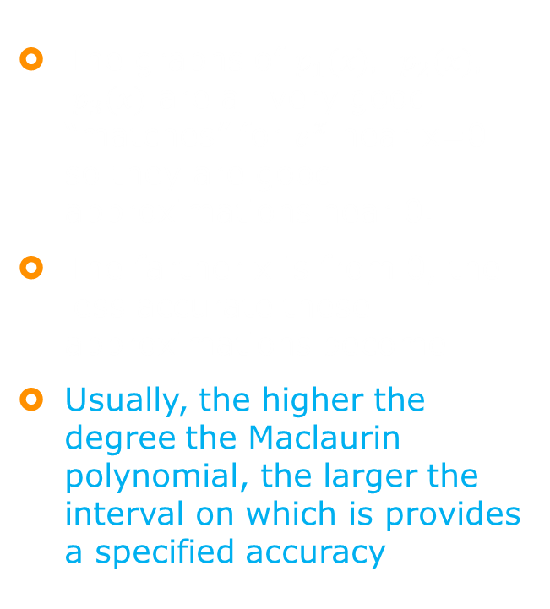
Analysis of Example Results
The graphs of $p_{1}(x), p_{2}(x), p_{3}(x)$ are all very good “matches” for $e^{x}$ near x=0 so they are good approximations near 0.
The farther x is from 0, the less accurate these approximations become.
Usually, the higher the degree the Maclaurin polynomial, the larger the interval on which is provides a specified accuracy.

Slide 12
Example
Find the nth Maclaurin polynomials for sin x.
Solution:
Start by finding several derivatives of sin x.
  f(x) = sin x f(0) = sin 0 = 0
  f’(x) = cos x f’(0) = cos 0 = 1
  f”(x) = -sin x f”(0) = -sin 0 = 0
  f’’’(x) = -cos x f’’’(0) = -cos 0 = -1
  f””(x) = sin x f””(0) = sin 0 = 0
  and the pattern (0,1,0,-1) continues to repeat for further derivatives at 0.

Slide 13
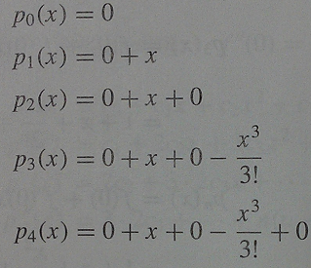
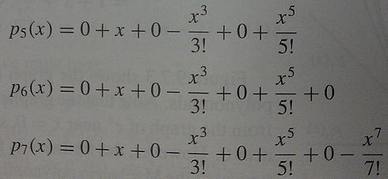
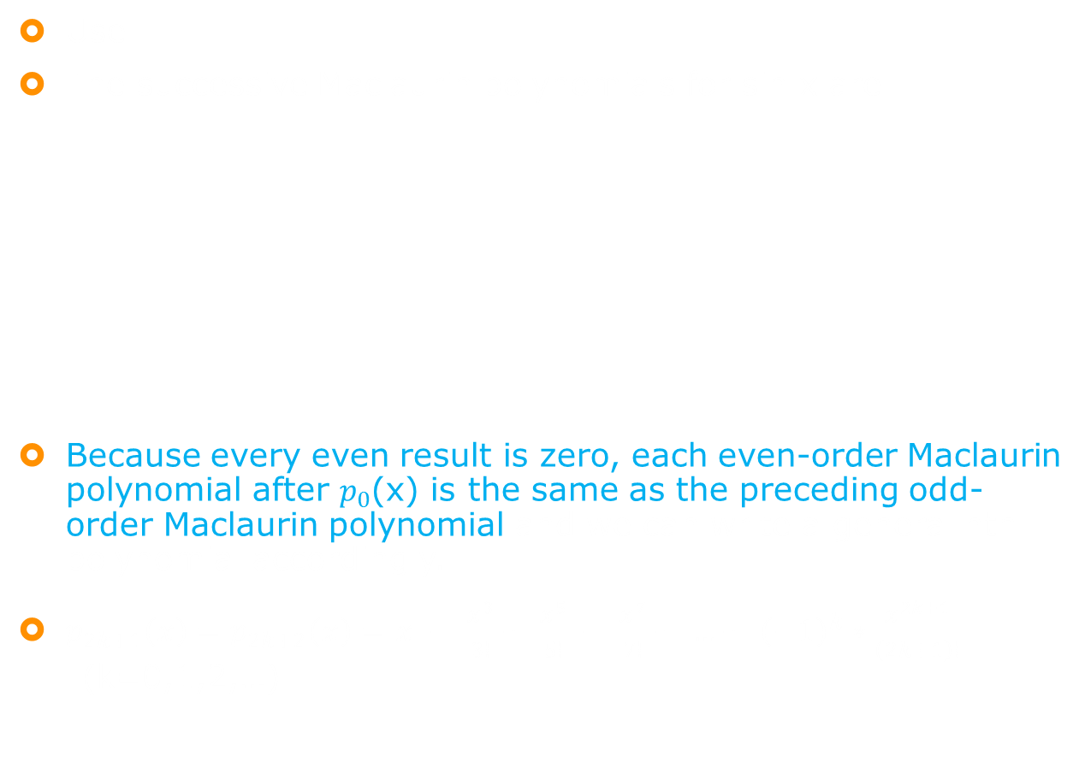
Example continued
Use
The successive Maclaurin polynomials for sin x are
Because every even result is zero, each even-order Maclaurin polynomial after $p_{0}$(x) is the same as the preceding odd-order Maclaurin polynomial and we can write a general nth polynomial accordingly.
$p_{2k+1}\left(x\right)=p_{2k+2}\left(x\right)=$ $x − \frac{x^{3}}{3!}+ \frac{x^{5}}{5!} − \frac{x^{7}}{7!}+ …+ {\left(−1\right)}^{k}∗\frac{x^{2k+1}}{\left(2k+1\right)!}$ (k=0,1,2,…)

Slide 14
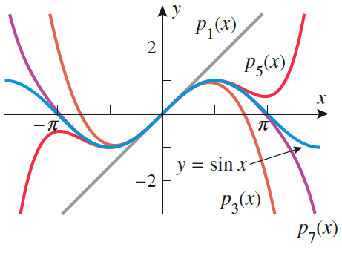
Graph of Example Results
If you are interested, see the nth Maclaurin polynomials for cos x on page 652.

Slide 15
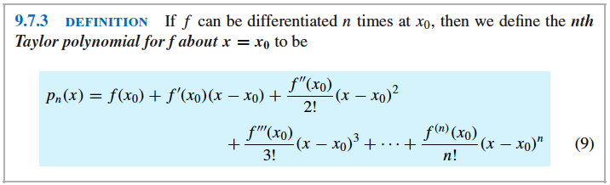

Taylor Polynomials
Until now, we have focused on approximating a function f in the vicinity of x = 0.
Now we will consider the more general case of approximating f in the vicinity of an arbitrary value of $x_{0}$.
The basic idea is the same as before; we want to find an nth-degree polynomial p such that its value and the values of its first n derivatives match those of f at $x_{0}$.
The substitution computations are much like those on slide #6 and they result in:

Slide 16
Brook Taylor (1685-1731)
Taylor polynomials are named after the English mathematician Brook Taylor who claims to have worked/conversed with Isaac Newton on planetary motion and Halley’s comet regarding roots of polynomials.
Supposedly, his writing style was hard to understand and did not receive credit for many of his innovations on a wide range of subjects – magnetism, capillary action, thermometers, perspective, and calculus.
See more information on page 653.
Remember, Maclaurin series came later and they are a more specific case of Taylor series.

Slide 17

Example
Find the first four Taylor polynomials for ln x about x = 2.
Solution:
Let f(x) = ln x f(2) = ln 2
Find the first three derivatives.
  f’(x) = $\frac{1}{x}$ f’(2) = $\frac{1}{2}$
  f”(x) = - $\frac{1}{x^{2}}$ f”(2) =- $\frac{1}{4}$
  f’’’(x) = $\frac{2}{x^{3}}$ f’’’(2) = $\frac{1}{4}$

Slide 18
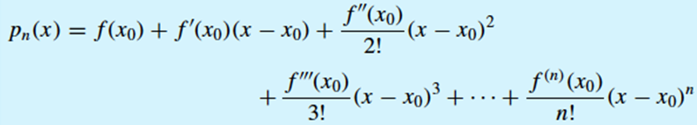
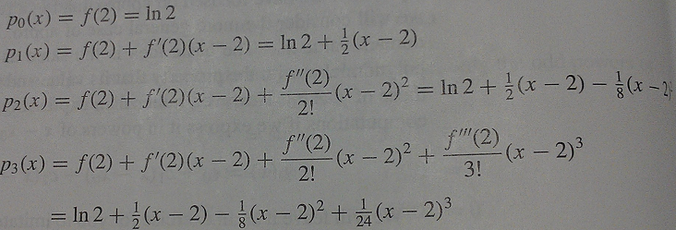

Example continued
Use combined with the results from the previous slide and $x_{0}=2$ to get

Slide 19

Sigma Notation for Taylor and Maclaurin Polynomials
We may need to express in sigma notation.
To do this, we use the notation $f^{\left(k\right)}(x_{0})$ to denote the kth derivative of f at x = $x_{0}$.
Hence, $f^{\left(0\right)}(x_{0})$ “no derivative” = original function at $x_{0}$ = f($x_{0}$).
This gives the Taylor polynomial $\sum_{k=0}^{n}{\frac{f^{\left(k\right)}\left(x_{0}\right)}{k!}}({x−x_{0})}^{k}=$
$$f{(x}_{0})+f^{′}\left(x_{0}\right)\left(x−x_{0}\right)+\frac{f"(x_{0})}{2!}{(x−x_{0})}^{2}+…+\frac{f^{\left(n\right)}\left(x_{0}\right)}{n!}{(x −x_{0})}^{n}$$
In particular, we can get the Maclaurin polynomial for f(x) as $\sum_{k=0}^{n}{\frac{f^{\left(k\right)}\left(0\right)}{k!}}({x−x_{0})}^{k}=$ $f(0)+f^{′}\left(0\right)x+\frac{f"(0)}{2!}x^{2}+…+\frac{f^{\left(n\right)}\left(0\right)}{n!}x^{n}$

Slide 20

Example
Find the nth Maclaurin polynomial for $\frac{1}{1−x}$ and express it in sigma notation.
Solution:
Let f(x) = $\frac{1}{1−x}$ f(0) = 1 = 0!
Find the first k derivatives at x = 0.
  f’(x) = $\frac{1}{{(1−x)}^{2}}$ f’(0) = $1=1!$
  f”(x) = $\frac{2}{{(1−x)}^{3}}$ f”(0) = 2 = 2!
  f’’’(x) = $\frac{3∗2}{{(1−x)}^{4}}$ f’’’(0) = $3!$
  f””(x) = $\frac{4∗3∗2}{{(1−x)}^{5}}$ f””(0) = 4!
  and so on
  $f^{\left(k\right)}$(x) = $\frac{k!}{{(1−x)}^{k+1}}$ $f^{\left(k\right)}$(0) = k!
Substitute into $\sum_{k=0}^{n}{\frac{f^{\left(k\right)}\left(0\right)}{k!}}({x−x_{0})}^{k}=$ $f(0)+f^{′}\left(0)x \right)+\frac{f"(0)}{2!}x^{2}+…+\frac{f^{\left(n\right)}\left(0\right)}{n!}x^{n}$ from the previous slide.
$p_{n}\left(x\right)= \sum_{k=0}^{n}{x^{k}=1+x+ }x^{2}$ + … + $x^{n}$ (n = 0, 1, 2, …)

Slide 21
Sigma Notation for a Taylor Polynomial
The computations and substitutions are similar to those in the previous example except you use the more general form .
See example 6 on page 655

Slide 22
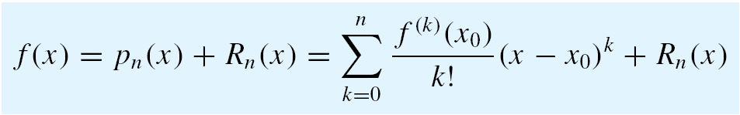

The nTH Remainder
It will be convenient to have a notation for the error in the approximation $f\left(x\right)≈ p_{n}\left(x\right).$
Therefore, we will let $R_{n}\left(x\right)$(the nth remainder) denote the difference between f(x) and its nth Taylor polynomial.
$R_{n}\left(x\right)$ = f(x) - $p_{n}\left(x\right)=f\left(x\right)−\sum_{k=0}^{n}{\frac{f^{\left(k\right)}\left(x_{0}\right)}{k!}}({x−x_{0})}^{k}$
original function – Taylor polynomial
This can be rewritten as
which is called Taylor’s formula with remainder.

Slide 23
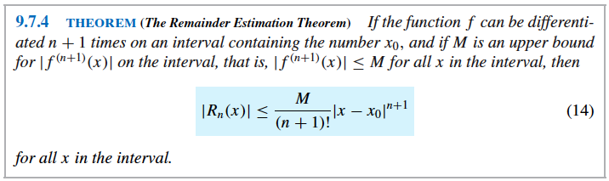


Accuracy of the Approximation $f\left(x\right)≈ p_{n}\left(x\right)$
Finding a bound for $R_{n}(x)$ gives an indication of the accuracy of the approximation $f\left(x\right)≈ p_{n}\left(x\right).$
If you are interested, there is a proof on pages A41-42.
This bound $\left|R_{n}(x)\right|$ is called the Lagrange error bound.

Slide 24


Example given accuracy
Use an nth Maclaurin polynomial for $e^{x}$ to approximate e to five decimal place accuracy.
Solution:
All derivatives of $e^{x}$ = $e^{x}$.
On slide #10, we found the nth Maclaurin polynomial for $e^{x}.$
$\sum_{k=0}^{n}{\frac{x^{k}}{k!}= }1+1x+ \frac{x^{2}}{2}+ \frac{x^{3}}{6}$ + … + $\frac{x^{n}}{n!}$
This gives $e= e^{1}≈$ $\sum_{k=0}^{n}{\frac{1}{k!}= }1+1+ \frac{1^{2}}{2}+ \frac{1^{3}}{6}$ + … + $\frac{1^{n}}{n!}$
Five decimal place accuracy means $±.000005$ or less of an error: $\left|R_{n}(x)\right|$ $≤$ .000005
To achieve this, use the Remainder Estimation Theorem with f(x)= $e^{x}$, x = 1, $x_{0}=0$ on the interval $[0,1]$ for the exponent.

Slide 25

Example continued
gives $\left|R_{n}(x)\right|$ $≤ \frac{M}{\left(n+1\right)!} ∗$ ${\left|1−0\right|}^{n+1}$= $\frac{M}{\left(n+1\right)!}$
M is an upper bound of the value of $f^{\left(n+1\right)}\left(x\right)=e^{x}$ for x in the interval [0,1].
$e^{x}$ is an increasing function, so its maximum value on the interval [0,1] occurs at x = 1: $e^{x}≤e$ on this interval which makes M = e for this problem.
$\left|R_{n}(x)\right|$ $≤ \frac{e}{\left(n+1\right)!}$
Since e is what we are trying to approximate, it is not very helpful to have e in the problem.
e<3 which is less accurate but easier to deal with.
$\left|R_{n}(x)\right|$ $≤ \frac{3}{\left(n+1\right)!}$ $\frac{3}{\left(n+1\right)!} ≤ .000005$ (n+1)!$≥$ 600,000
9!=362,880 which is the smallest value of n that gives the required accuracy since 10!=3,628,800
$\sum_{k=0}^{n}{\frac{x^{k}}{k!}= }1+1x+ \frac{x^{2}}{2}+ \frac{x^{3}}{6}$ + … + $\frac{x^{n}}{n!}$ gives $1+1+ \frac{1^{2}}{2}+ \frac{1^{3}}{6}$ + … + $\frac{1^{9}}{9!}≈$
$2.71828$

Slide 26

Another Accuracy Example
Use the Remainder Estimation Theorem to find an interval containing x=0 throughout which f(x)=cos x can be approximated by p(x) = 1 – ($\frac{x^{2}}{2!}$) to three decimal-place accuracy.
Solution:
  f must be differentiable n+1 times on an interval containing the number x=0 according to the theorem and cos x is differentiable everywhere.
  Similar to f(x)=sin x on slides #12-13, p(x) is both the second and third Maclaurin polynomial for cos x.
  When this happens you want to choose the degree of n of the polynomial to be as large as possible, so we will take n=3.
  Therefore, we need $\left|R_{3}(x)\right|$ $≤$ .0005

Slide 27
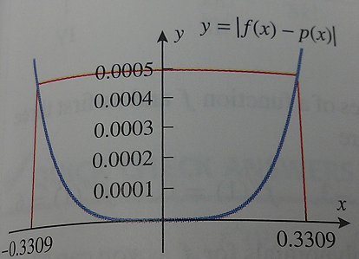

Example continued
  This gives us $\left|R_{3}(x)\right|$ $≤ \frac{M}{\left(3+1\right)!} ∗$ ${\left|x−0\right|}^{3+1}$= $\frac{M{\left|x\right|}^{4}}{24}$ where M is an upper bound for
  $\left|f^{\left(4\right)}(x)\right|=\left|\cos{x}\right|$.
  Since $\left|\cos{x}\right|≤1$for every real number x, we can take M=1 as that upper bound.
  $\left|R_{3}(x)\right|$ $≤$ $\frac{{\left|x\right|}^{4}}{24}$ $\frac{{\left|x\right|}^{4}}{24}≤.0005$ $\left|x\right|≤.3309$
  This tells us that one interval is
  [-.3309,.3309] which we can check by
  graphing $\left|f\left(x\right)−p(x)\right|$
  original function – Taylor polynomial

Slide 28

Getting Ready to Race

